Slide 2
Learning Objectives (1 of 2)
Discuss the reasons for globalization and for using global information systems, including e-business and Internet growth
Describe global information systems and their requirements and components

Slide 3
Learning Objectives (2 of 2)
Explain the types of organizational structures used with global information systems
Discuss obstacles to using global information systems

Slide 4
Why Go Global? (1 of 3)
Global economy
Creating increased customer demand for integrated worldwide services
Expansion of global markets
Major factor in developing global information systems whose success requires understanding:
Customs and laws
Technological issues
Local business needs and practices

Slide 5
Why Go Global? (2 of 3)
Increased importance of global products in international marketing efforts
Operations are often regionalized; advantages available in certain regions
Important factor in purchasing and the supply chain
Worldwide purchasing provides suppliers the incentive to consider domestic and foreign competition

Slide 6
Why Go Global? (3 of 3)
Large global organizations can reduce costs in purchasing, manufacturing, and distribution
Access to cheaper labor
Ability to sell products and services locally and internationally

Slide 7
E-Business: A Driving Force (1 of 2)
Major factor in the widespread use of global information systems
Revenue-generating transactions; focus on buying and selling goods and services
Adds flexibility to existing advantages and structures of traditional business
Creates new opportunities for conducting commercial activities

Slide 8
E-Business: A Driving Force (2 of 2)
Enables consumers to indulge in comparison shopping
New opportunities for intermediaries
Provides cost benefit to small companies
Companies can replace internal networks with the Internet

Slide 9
Growth of the Internet
Part of daily life in most parts of the world
Rapidly growing; requires global businesses to create Web sites that appeal to the global customer
Localization of a Web site: creating separate Web sites for each country in which the company does business

Slide 10
The Rise of Non-English Speakers on the Internet
Top ten languages represent about 84 percent of the world’s Internet users
English, Chinese, Spanish, Arabic, Portuguese, Japanese, Russian, Malay, French, and German
Growing diversity of language on the Internet
Offers great opportunities and some challenges for global companies

Slide 11
Mobile Computing and Globalization
Mobile apps play a major role in globalization by offering basic social services and commerce
M-Pesa
SoukTel
Esoko
Frogtek
Ver Se’ Innovation

Slide 12
Global Information Systems: An Overview (1 of 2)
Global Information System (GIS): information system that works across national borders
Facilitates communication between headquarters and subsidiaries
Incorporates technologies and applications found in a typical information system
Gathers, stores, manipulates, and transmits data across cultural and geographic boundaries

Slide 13
Global Information Systems: An Overview (2 of 2)
Enables international companies to:
Increases control over their subsidiaries
Better coordinates activities and access new global markets
Defined along the dimensions of control and coordination
Dimensions can be used in combinations

Slide 14
Components of a Global Information System (1 of 3)
Global database
Challenges: designing and implementing a global database and currency conversion
Information-sharing technologies
Companies can outsource or customize technologies

Slide 15
Components of a Global Information System (2 of 3)
Responsibilities of information system managers
Determine the best communication media to meet global performance and traffic needs
Choose the best transmission technology for the global network’s needs
Consider the company’s objectives when determining the network architecture
Decide on the type of information-sharing technology to be used

Slide 16
Components of a Global Information System (3 of 3)
Standardized software and hardware are ideal but not always feasible
Using the same software in other countries is complicated because of differences
Language and business practices
Transborder data flow (TDF): restricts what type of data can be captured and transmitted

Slide 17
Requirements of Global Information Systems (1 of 2)
Multinational corporation (MNC)
Organization with assets and operations in at least one country other than its home country
Delivers products and services across national borders
Centrally managed from its headquarters
Global risks of operating an MNC: political, foreign exchange, and market risks

Slide 18
Requirements of Global Information Systems (2 of 2)
GIS classifications
Operational support: involves day-to-day activities
Tactical support: concentrates on medium-range activities that move toward long-term goals
Strategic support: includes broad and long-term goals

Slide 19
Implementation of Global Information Systems (1 of 2)
Implementing a GIS can be difficult
Differences in culture, politics, social and economic infrastructures, and business methods
Varying international policies, which affect communication and standardization processes

Slide 20
Implementation of Global Information Systems (2 of 2)
Issues to be addressed before implementing a GIS
Identify business opportunities in the global marketplace
Justify an organization’s investment in a GIS
Screen personnel needs for technical and business expertise
Carefully coordinate migration to GIS

Slide 21
Organizational Structures and Global Information Systems
Organization’s structure determines the architecture of its GIS
Types of organizations that conduct international business
Multinational organizations
Global organizations
International organizations
Transnational organizations

Slide 22
Multinational Structure (1 of 2)
Production, sales, and marketing are decentralized
Financial management is the parent company’s responsibility
Advantage
Reduces the need for communication between subsidiaries and headquarters
Enables subsidiaries to make decisions on their own

Slide 23
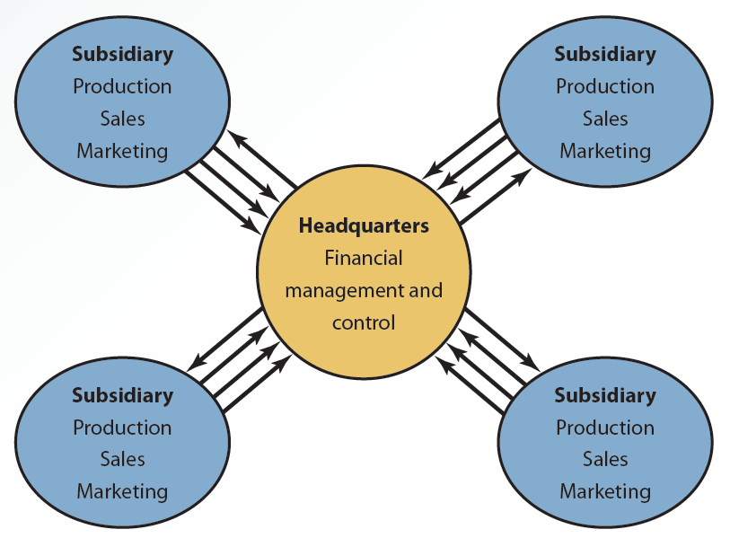
9.1 Multinational Structure (2 of 2)

Slide 24
Global Structure (1 of 3)
Uses highly centralized information systems
Subsidiaries have less autonomy
Rely on headquarters for all process and control decisions, as well as system design and implementation
Requires an extensive communication network
GIS fits well

Slide 25
Global Structure (2 of 3)
Integration needed to manage production, marketing, and human resources is difficult
Caused by heavy reliance on headquarters
Duplicate information systems have to be developed to attain efficiency
Subsidiaries have the responsibility of selling, marketing, and tailoring the products to their countries’ requirements and tastes

Slide 26
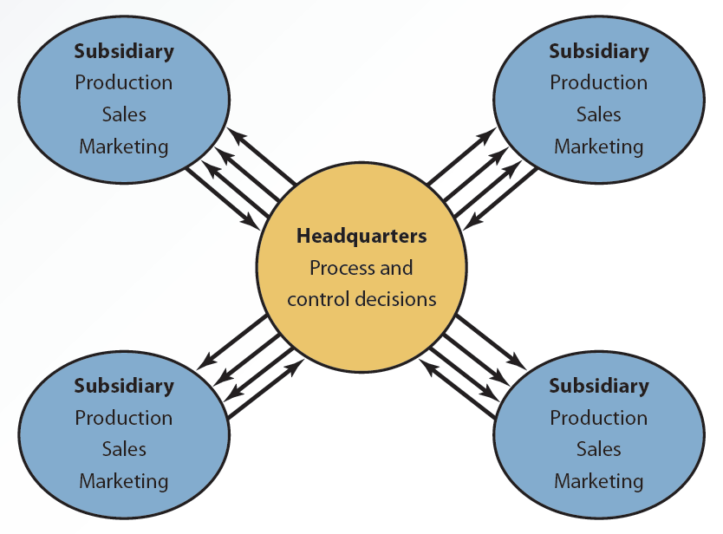
9.2 Global Structure (3 of 3)

Slide 27
International Structure (1 of 2)
Organization operates like a multinational corporation
Subsidiaries depend on headquarters for process and production decisions
Information systems personnel are regularly exchanged among locations
Encourages a cooperative culture, which increases feasibility of a GIS
GIS can be centralized or decentralized, depending on the extent of cooperation

Slide 28
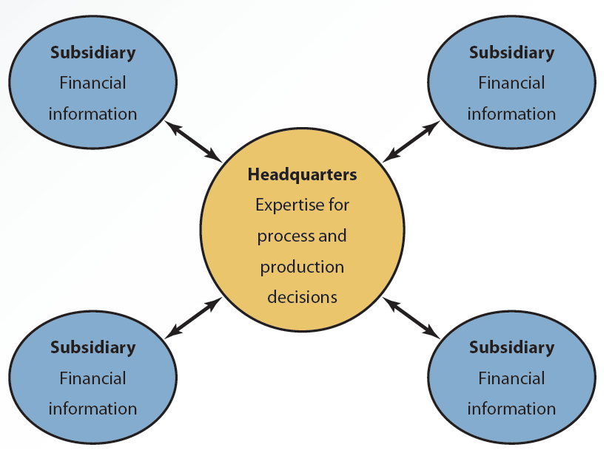
9.3 International Structure (2 of 2)

Slide 29
Transnational Structure (1 of 3)
Parent company and subsidiaries work together
Design policies, procedures, and logistics for delivering products and services to the right market
Organization’s headquarters is not set up in a particular country
Regional divisions share authority and responsibility

Slide 30
Transnational Structure (2 of 3)
Organization focuses on:
Optimizing supply sources
Using advantages available in subsidiary locations
GIS requires high standardization and uniformity for global efficiency
Local responsiveness should be maintained
Integration of GIS is enhanced by universal data dictionaries and standard databases

Slide 31
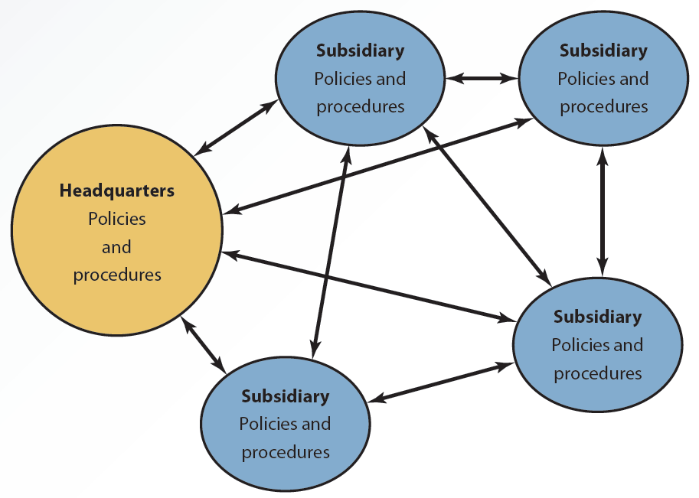
9.4 Transnational Structure (3 of 3)

Slide 32
Global Information Systems Supporting Offshore Outsourcing (1 of 2)
Organizations choose an outsourcing firm in another country that can provide services and products
Used for many information technology tasks
Attractive for all types of organizations
Widespread availability of the Internet
Improved telecommunication systems
Reduced cost of communication
Increased bandwidth

Slide 33
Global Information Systems Supporting Offshore Outsourcing (2 of 2)
Supported by a GIS, which provides a global network
Network can be used by all participants for coordinating development activities

Slide 34
Obstacles to Using Global Information Systems
Many factors can hinder success
Lack of standardization
Cultural differences
Diverse regulatory practices
Poor telecommunication infrastructures
Lack of skilled analysts and programmers

Slide 35
Lack of Standardization
Lack of standardization can impede the development of a cohesive GIS
Impractical to work with various standards
Inability to meet the costs of integrating different platforms
Excessive standardization
Decreases organizational flexibility in responding to local preferences
Difficulties posed by time zones
Backup and maintenance

Slide 36
Cultural Differences
Differences in values, attitudes, and behaviors play an essential role in using GISs
Web site content or images would have to be changed to suit the target market
Best addressed with education and training

Slide 37
Diverse Regulatory Practices
Apply to policies on business practices and technological use
Jurisdiction issues regarding the contents of a GIS
Nature of intellectual property laws and how they are enforced
Other legal issues
Privacy and cybercrime laws, censorship, and government control

Slide 38
Poor Telecommunication Infrastructures (1 of 2)
Organizations must consider telecommunication infrastructures in subsidiary countries
Implementation of a GIS could be expensive and cumbersome when each subsidiary country has different:
Service offerings
Price schedules
Policies

Slide 39
Poor Telecommunication Infrastructures (2 of 2)
Countries with slow and costly access to the Internet
Web pages with content that contains high bandwidth graphics and animations must be avoided
Differences in standards can cause problems

Slide 40
Lack of Skilled Analysts and Programmers
Nature of culture and differences in skills in other countries must be considered when forming teams
Cultural and political differences affect cooperative environment
Training and certification programs offered through the Internet can reduce skills gap in developing nations

Slide 41
Summary
Globalization has become an important factor in purchasing and the supply chain
GIS is an information system that works across national borders
Organization's structure determines the architecture of its GIS
Some of the obstacles in using a GIS include lack of standardization and cultural differences

